Slide 2
Creative Ways to Make the Most of your Career Development Professional
I thought they were called
a ‘Careers Adviser’?
From the perspective of a Career Development Professional:
Jules Benton LLB, Dip CG
Independent Consultant and Trainer

Slide 3
Statutory guidance for schools and
guidance for further education colleges
and sixth form colleges
July 2021
www.gov.uk/government/publications/careers-guidance-provision-for-young-people-in-schools

Slide 4
Benchmark 8: Personal guidance
Every student should have opportunities for guidance interviews with a career adviser, who could be internal (a member of school or college staff) or external, provided they are trained to an appropriate level.*
These should be available for all students whenever significant study or career choices are being made. They should be expected for all students but should be timed to meet their individual needs. • Every student should have at least one such interview by the age of 16, and the opportunity for a further interview by the age of 18, by the end of their study programme.
* The school or college should ensure that access to an adviser trained to level 6 is available when needed.

Slide 5
There is good evidence which demonstrates the impact of personal guidance. This evidence is able to draw on a number of randomised
control trials, longitudinal studies and meta-analyses. It is associated with a range of short and long-term impacts on an individual’s:
• personal effectiveness e.g. self-awareness and self-esteem;
• career readiness e.g. career planning and decision making; and
• educational outcomes e.g. improved attendance and attainment.
https://resources.careersandenterprise.co.uk/sites/default/files/2021-09/what-works-personal-guidance.pdf

Slide 6
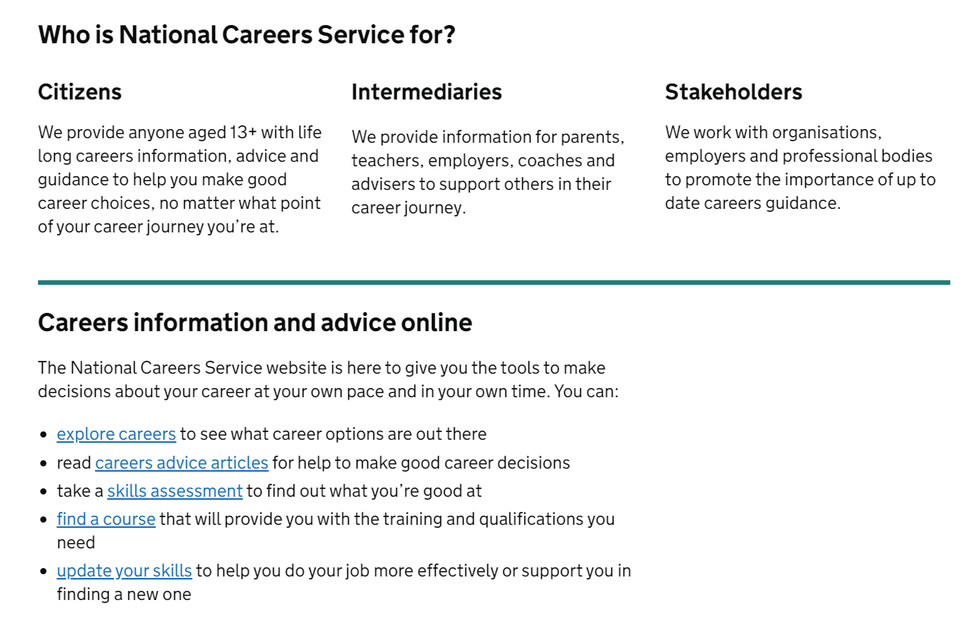
Some Advisers may be qualified to level 6/7 but the requirement for NCS advisers is only Level 4
I thought they were called
a ‘Careers Adviser’?
nationalcareers.service.gov.uk

Slide 7
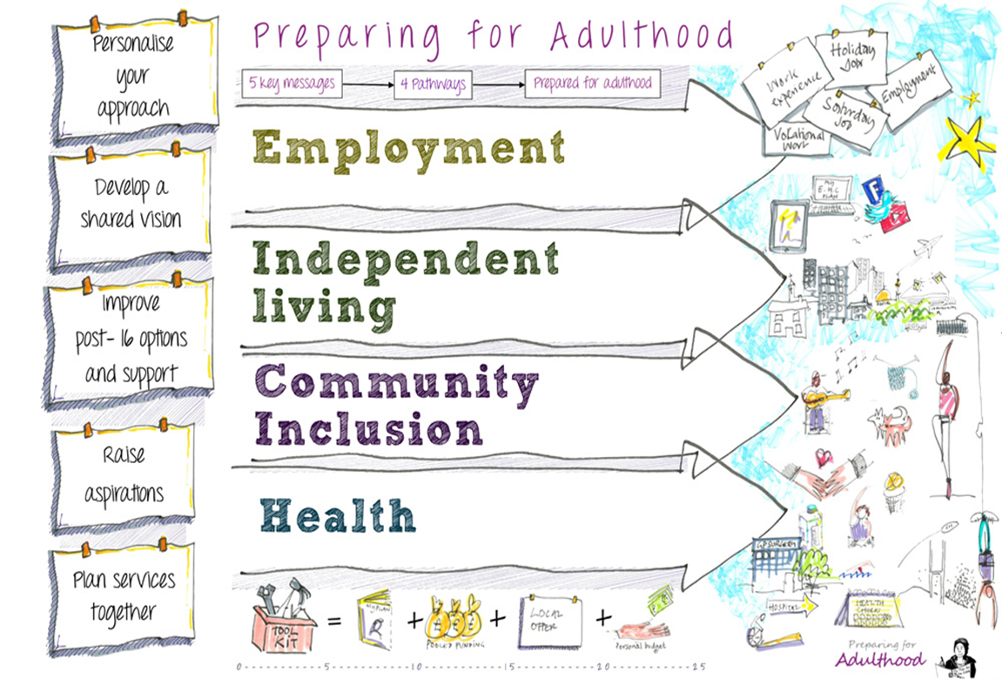
Prepare your students
and their circles of support
www.preparingforadulthood.org.uk

Slide 8
Prepare your students
and their circles of support
Information, Advice and Guidance
Make sure people understand the difference
Put it on your website
Explain during careers education
Display it at parent/carer events
Include this in staff training
Provide an introduction to your careers adviser which explains their role…and signposts to sources of information and advice
http://www.thecdi.net/write/Documents/CDI_The_differences_between_career_information_and_guidance.pdf

Slide 9
Prepare your students
and their circles of support
Make arrangements for providing young people, and their parent carers, with advice and information about matters relating to SEN and disability
Utilise funded services such as…
SENDIASS
councilfordisabledchildren.org.uk/what-we-do-0/networks/information-advice-and-support-services-network/find-your-local-ias-service
Disability Rights UK
www.disabilityrightsuk.org/how-we-can-help/advice-and-information
Contact
contact.org.uk
Use your guidance professional to deliver career guidance!

Slide 10
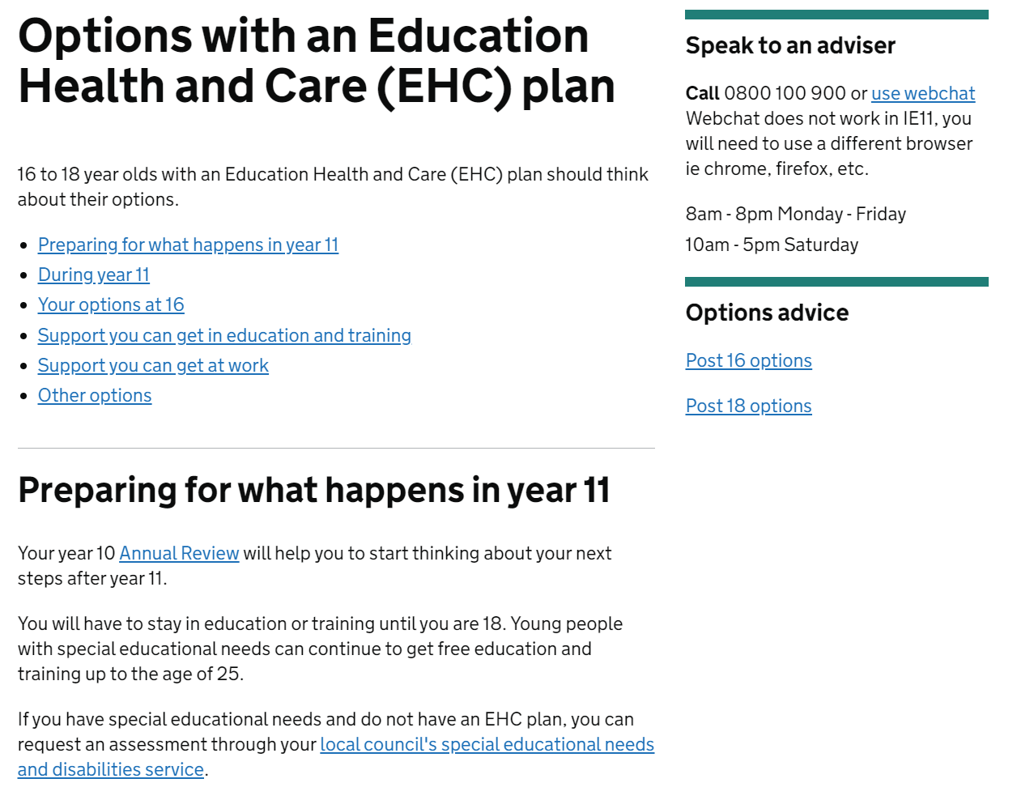
https://nationalcareers.service.gov.uk/careers-advice/options-with-education-health-and-care-plan/

Slide 11
Prepare your students
and their circles of support
Reduce anxiety
Career guidance has no rights and wrongs – it is about exploring ideas and being supported to plan in a way that suits YOU
It is not a one-off – people can take time to make choices, and it is OK to change your mind… or not have any idea what you want just yet
It can be fun!!!
To see a Career Guidance Professional showing you how to have fun with decision-making watch Katherine : https://whatsyourstrength.co.uk/videos/

Slide 12
Prepare your students
and their circles of support
Mental Capacity
The legal concept of mental capacity is contained in the Mental Capacity Act 2005 and the Mental Capacity Act Code of Practice, which is statutory guidance.
Mental capacity is assessed in relation to the particular decision which needs to be made. This means that whether a young person has mental capacity to make a particular decision or not has to be considered on an individual basis in the light of the circumstances at the time.
www.preparingforadulthood.org.uk/downloads/young-people-and-family-participation/factsheet-the-mental-capacity-act-2005-and-supported-decision-making.htm

Slide 13
Prepare your students
and their circles of support
Practice
People are afraid of making mistakes
Practice the skills involved in decision-making with your students
Answering questions
Asking questions
Using an advocate
Talking about yourself
Expressing feelings
Trying things out so see what happens – NOT to ‘succeed’ or ‘fail’
When we have a growth mindset we take on challenges and learn from them, therefore increasing our abilities and achievement. Learn about the power of ‘yet’ from Carol Dweck https://www.youtube.com/watch?v=hiiEeMN7vbQ

Slide 14
Prepare your students
and their circles of support
Words
Use, and explain, the words young people will hear in their transition to adult life:
Skills
Strengths
Apprenticeship
Work
College
Higher Education
Training
Induction
Supported internship
Mental capacity
Confidentiality
Data protection
Person centred plans
Advocacy
CV
Application
Reasonable adjustments
Disability confident
Access to Work
Disabled
Transition
Career

Slide 15
Prepare your students
and their circles of support
Write it down…or draw it…

Slide 16
Prepare your students
and their circles of support
Communication
Make sure the guidance professional knows how the person communicates best – a personal communication plan may be useful
Consider whether the environment is suitable for a confidential interview - and if it meets the needs of the individuals
Is there information already available which outlines communication or support needs and strategies that work for this young person? Ask the student’s permission to share this
Are there other people who will make, or help make, decisions with the young person? Be specific about how the young person wants, or needs, these people involved

Slide 17
Prepare your students
and their circles of support
Person-Centred Resources

Slide 18
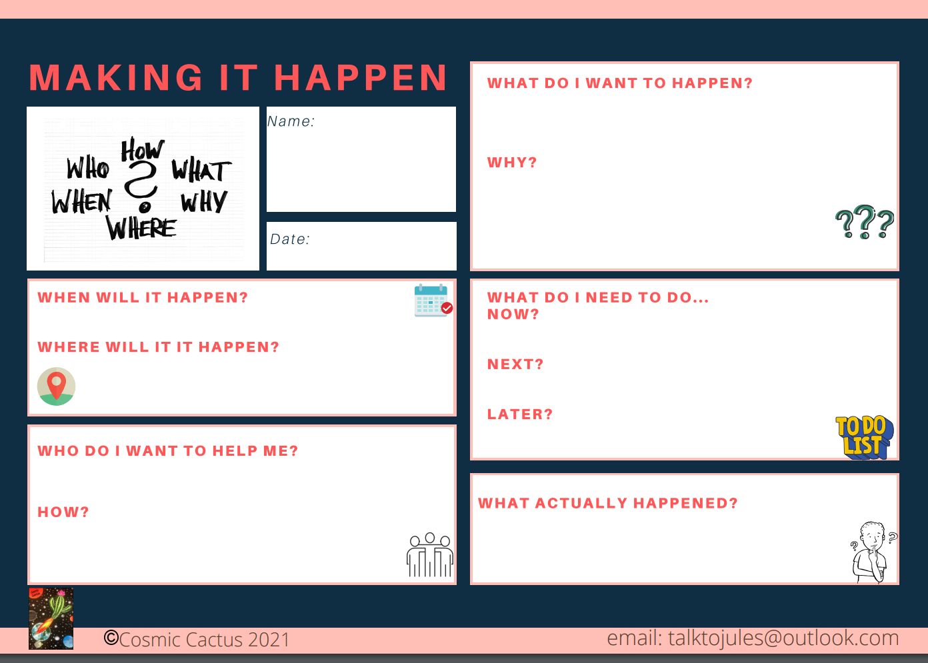
Prepare your students
and their circles of support
Plan, Do, Review

Slide 19
Prepare your students
and their circles of support
Ensure parents/carers, your Career guidance professional and young people are
fully aware of and included in your Careers Education programme
aware of the opportunities available to young people moving on from your provision (link ‘The Local Offer’ to your website)
consulted about the content and impact of your Careers Education programme. This can be linked specifically to transition outcomes for a student on their EHCP
aware of the roles of everyone involved in Careers education, IAG and planning for your setting
https://www.preparingforadulthood.org.uk/SiteAssets/Downloads/yeded5wb636481748062535810.pdf

Slide 20
Prepare your students
and their circles of support
Share some of the great resources available:
www.preparingforadulthood.org.uk/downloads/person-centred-planning
https://resources.careersandenterprise.co.uk/browse-category/send?filter=&page=1
And do encourage your young people to make and share their own!
Use your guidance professional to deliver career guidance!

Slide 21
talktojules@outlook.com
​
07305 857028
linkedin.com/in/jules-benton-31b90242/

